Slide 1
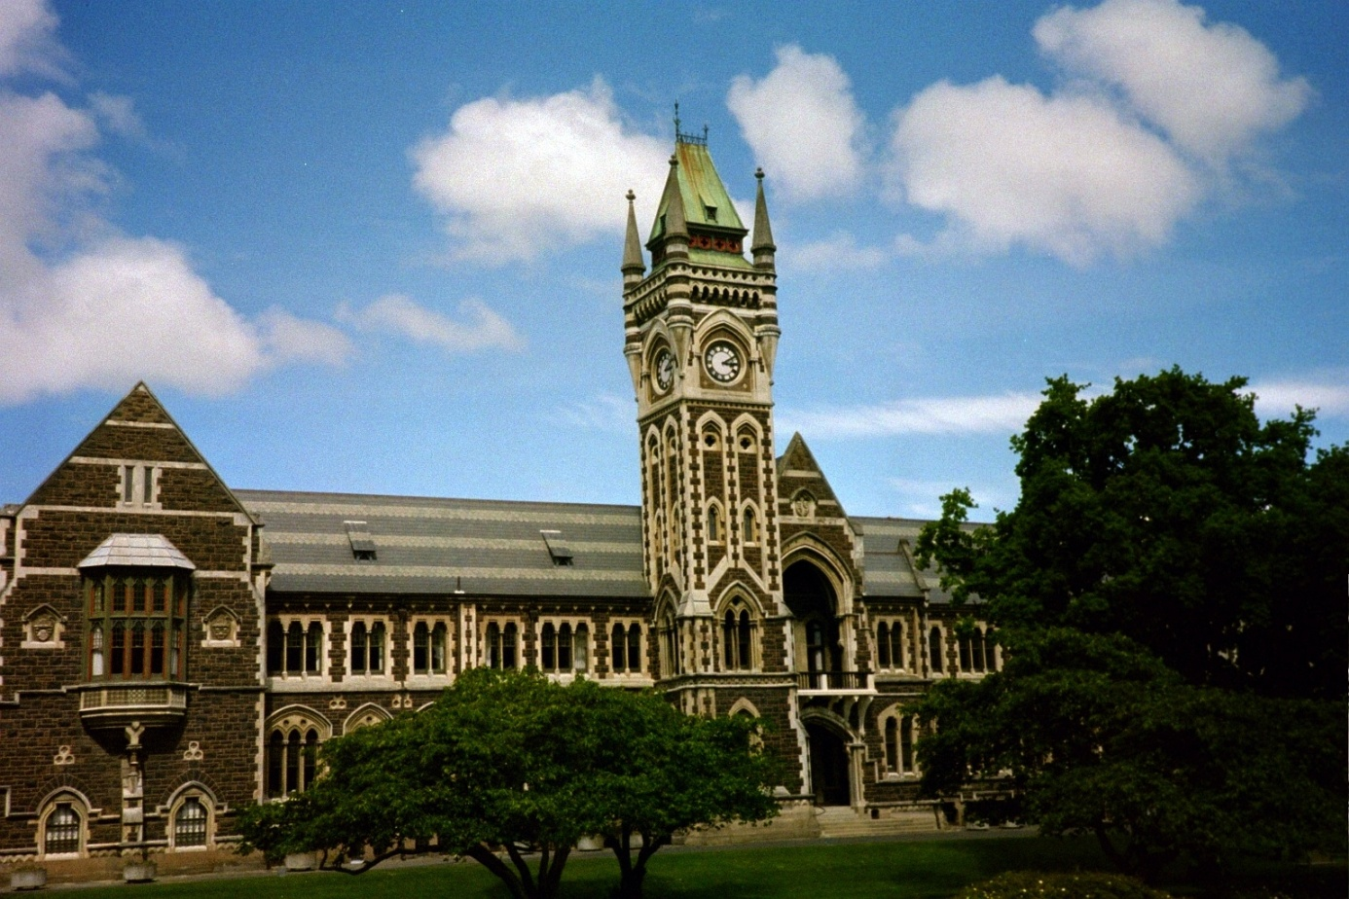
Can we build individual molecules atom by atom?
Mikkel F. Andersen
Jack Dodd Centre for Quantum Technology, Department of Physics, University of Otago.

Slide 2
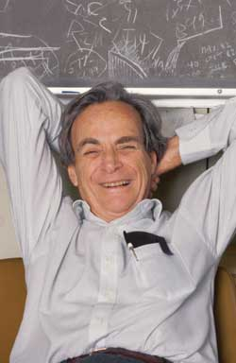
Can we build individual molecules atom by atom?
Richard Feynman 1959:
“There's Plenty of Room at
the Bottom”

Slide 3
Do we in 2014 have the toolbox required to realize Feynman’s dream?

Slide 4
Outline
Lecture 1: Atoms in light
  Two-level atoms in light
  Optical forces on atoms in light
  Cooling atoms with light
  Trapping atoms with light
Lecture 2: Basic molecular physics
Lecture 3: Light induced molecule formation processes
Lecture 4: State of the field and how to proceed

Slide 5


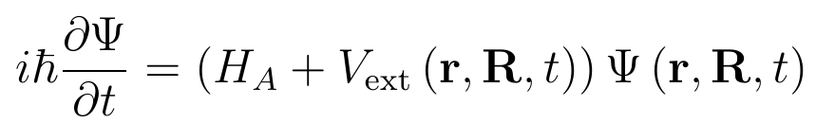
An atom in light

Slide 6

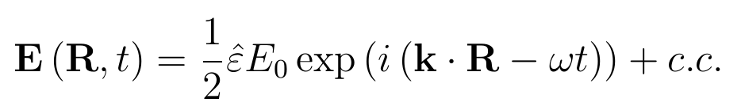
The Interaction with the Light
Assume that the atom is much smaller than the wavelength of light:

Slide 7



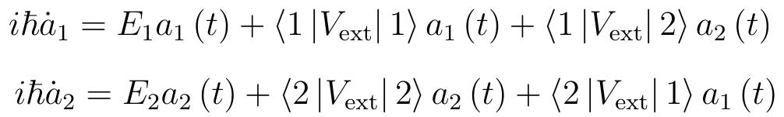
Two-Level Atom fixed at the origin
Assume R=0 and only two internal states play a role in the internal
Dynamics:
Plug into Schrödinger equation:
Take inner product with and :

Slide 8

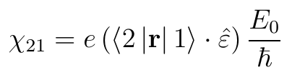

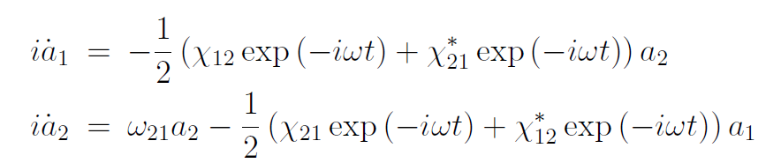
Rewriting:
Recall:
Define:
And take . The S.E. then becomes:

Slide 9

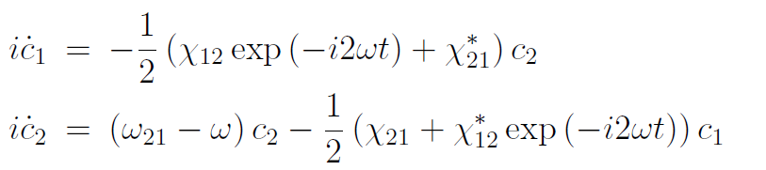
Rotating wave approximation
Define:
For the c-coefficients we obtain:

Slide 10
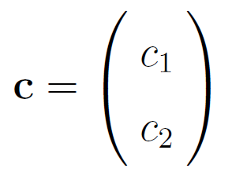


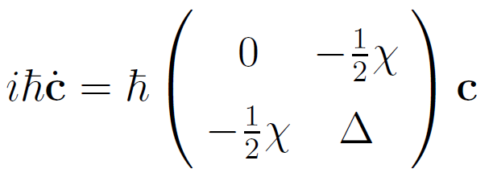

It is now very simple!
With: , , and

Slide 11
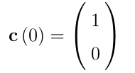
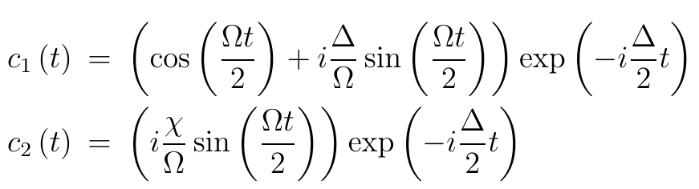
Solution
For

Slide 12
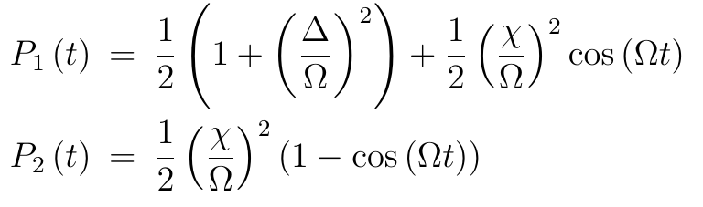
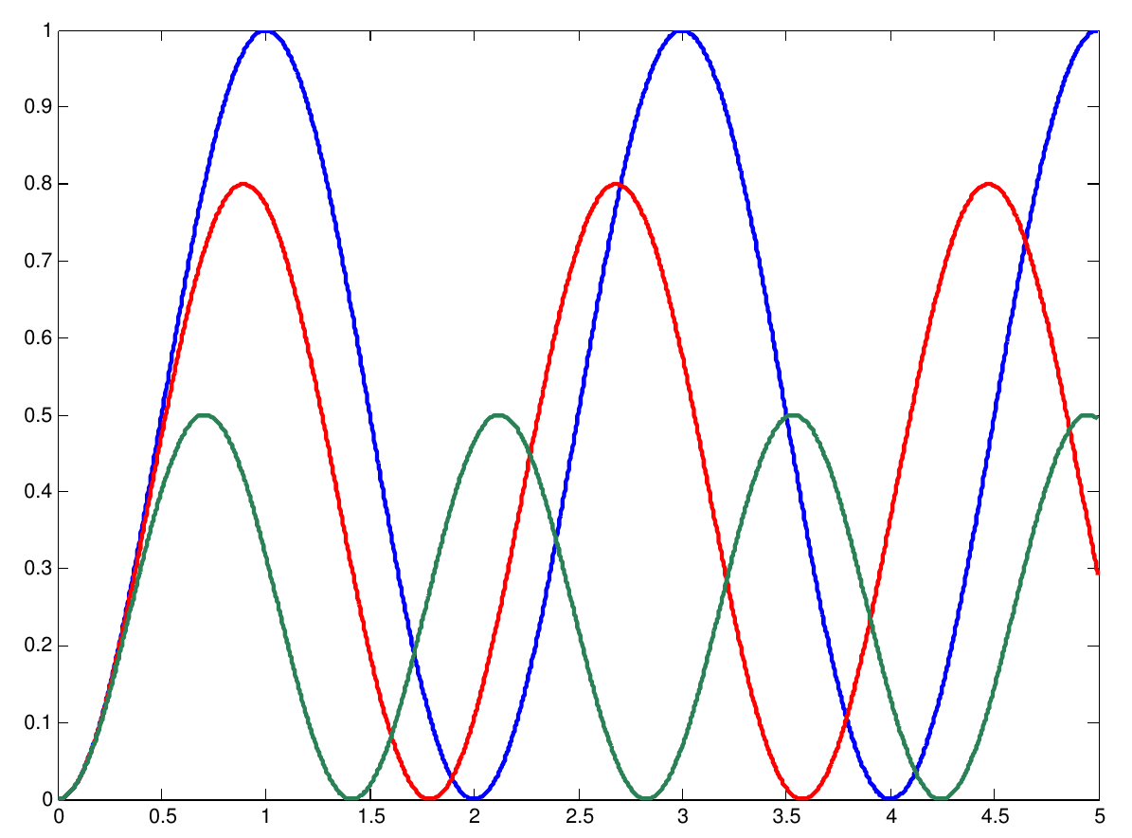


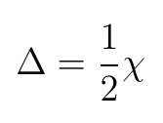


Rabi-Flopping

Slide 13


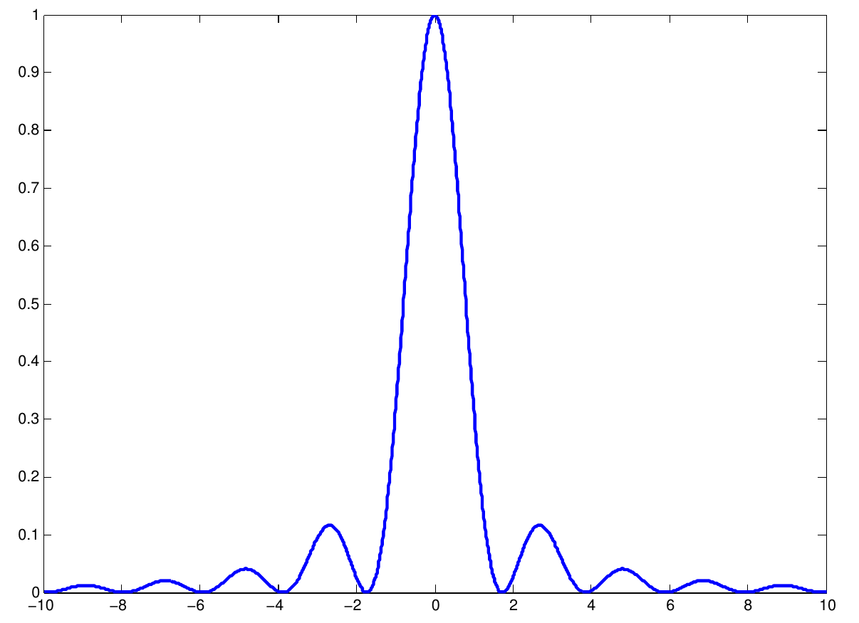

Excitation close to resonance
For:

Slide 14
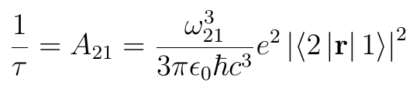
Spontaneous emission

Slide 15








Include CM motion of atom
1. Expand on eigen-states of
2. Plug into time dependent Schrödinger equation
3. Take inner product with eigen-state of to obtain coupled equations for ,
4. Observe that since the dependence of on the atoms center of mass coordinate goes like then the equation for only contains and
5. Change from ɑ to c and do rotating wave approximation
6. We now arrive at a problem that is mathematically identical to when we ignored CM motion but with a couple of modifications

Slide 16


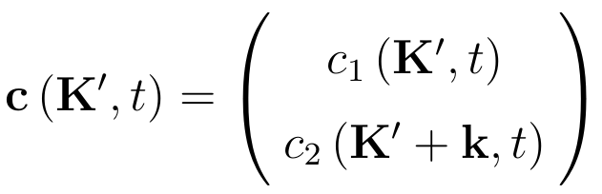
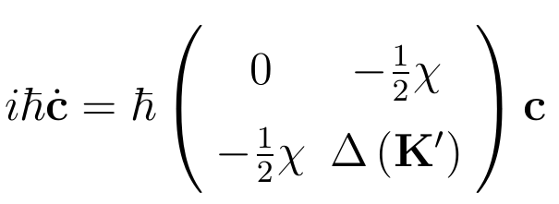
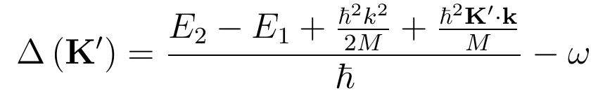
Modifications
is only coupled to and vice versa. The atom changes center of mass momentum when it absorbs or emits light
Because the atom changes center of mass momentum when it absorbs or emit light its center of mass energy changes as well. This leads to a momentum dependent resonance frequency. The Doppler effect.

Slide 17

Radiation Pressure

Slide 18
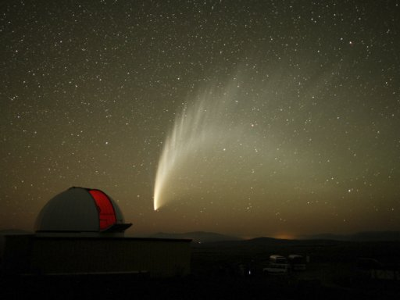
Radiation pressure

Slide 19
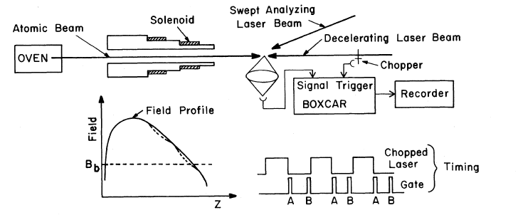
Application 1: Slowing of atoms

Slide 20
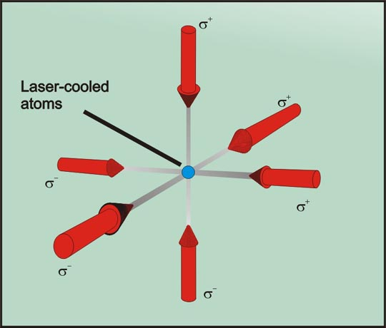
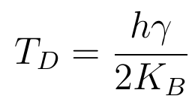
Application 2: Doppler cooling

Slide 21
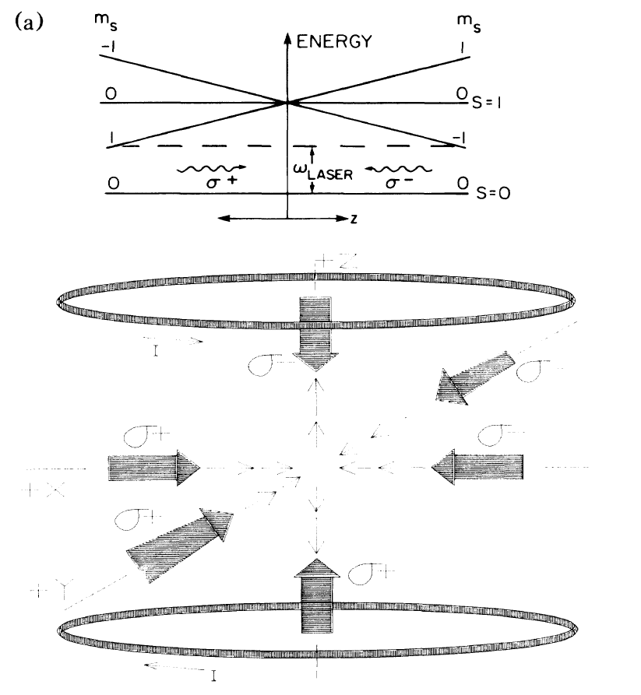
Application 3: MOT

Slide 22









Selection rules:
( Forbidden)
( Forbidden)

Slide 23
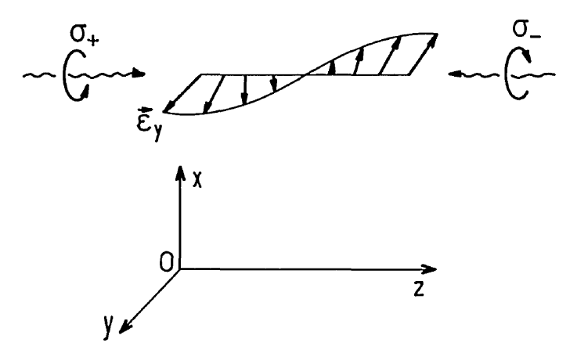
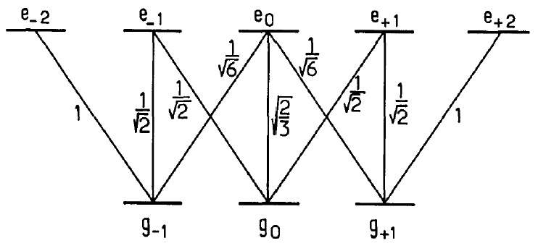
Sub-Doppler cooling

Slide 24
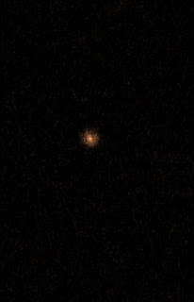

Optical dipole force (far off resonance)
k

Slide 25
Summery Lecture 1
Few-level atoms in light can be treated using rotating wave approximation
Two-level atoms exposed to near-resonant light undergo Rabi-flopping cycles of absorption an stimulated emission
Atoms in an excited electronic state can spontaneously emit light and go to a lower energy state
Cycles of absorption and spontaneous emission result in a directional radiation pressure force
Radiation pressure can be used to cool and trap atoms
Far off resonant light interacts with the atoms via the optical dipole force

